Slide 1

Hypothesis Testing-Part 1
Xinyu Meng xm73
Feb 26th, 2023

Slide 2
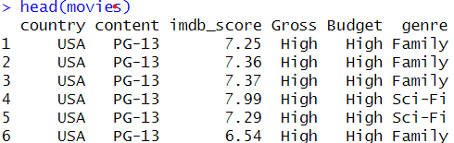
The Data Set
The movies data set contains imdb score of 12800+ movies along with attributes including budget, gross, genre, content, and country.

Slide 3
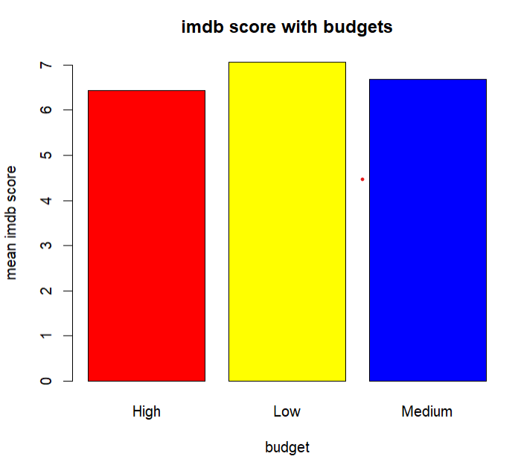
Alternative Hypothesis: R movies with higher budget tends to have lower imdb scores
To support this hypothesis, we can create a bar plot of IMDb scores with the three categories of budgets.
Then with the following code, we can identify the pattern of movies with R content and lower imdb score with respect of budget.
barplot(tapply(movies[movies$content=='R',]$imdb_score, movies[movies$content=='R',]$Budget, mean), main='imdb score with budgets', xlab='budget', ylab='mean imdb score', col=c('red','yellow','blue','green'))

Slide 4
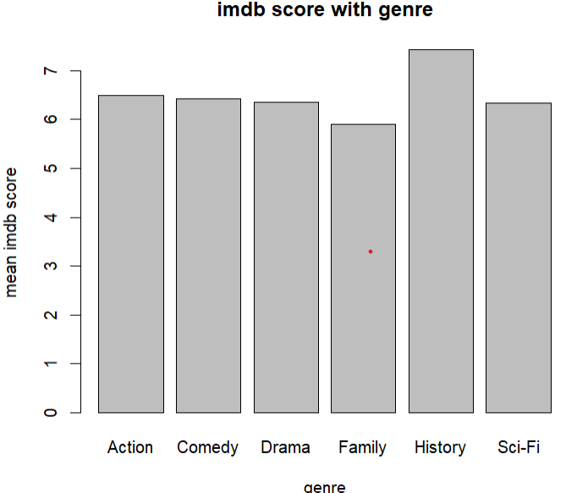
Alternative Hypothesis: Drama movies tend to have higher IMDb scores than Science Fiction movies
To support this hypothesis, we can create a barplot of IMDb scores for each genre and compare the mean across the different genres. If the mean for history movie is significantly higher than the means for the other genres, the alternative hypothesis would be promising.
barplot(tapply(movies$imdb_score, movies$genre, mean), main='imdb score with genre', xlab='genre', ylab='mean imdb score')

Slide 5
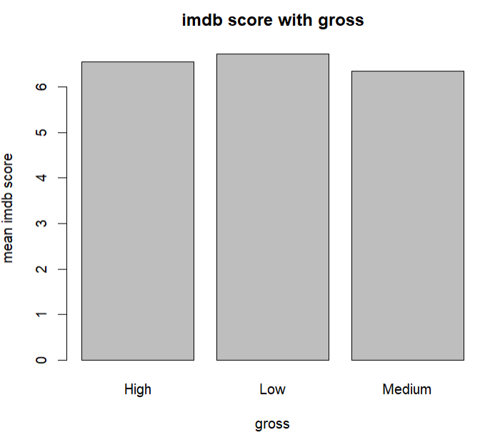
Alternative Hypothesis: movies with low gross tend to have higher IMDb scores than movies with higher gross
To support this hypothesis, we can create a barplot of IMDb scores for each different gross and compare the mean across the movies with different grosses. If the mean for low gross movie is significantly higher than the means for the other movies, the alternative hypothesis would be promising.
barplot(tapply(movies$imdb_score, movies$Gross, mean), main='imdb score with gross', xlab='gross', ylab='mean imdb score')

Slide 6
Hypothesis Testing-Part 2
Xinyu Meng xm73
Feb 26th, 2023

Slide 7
Hypothesis A:High budget R movies have lower mean imdb scores than low budget R movies Null Hypothesis: There is no significant difference in the average imdb scores between high budget R movies and low budget R moveis
Approach: Z-test

Slide 8
We use BSDA library z.test to run z-test on the hypothesis.
low_budget<-movies[movies$content=='R' & movies$Budget=='Low',]high_budget<-movies[movies$content=='R' & movies$Budget=='High',]z.test(x=low_budget$imdb_score,y=high_budget$imdb_score, alternative='greater', sigma.x=sd(low_budget$imdb_score), sigma.y=sd(high_budget$imdb_score))

Slide 9
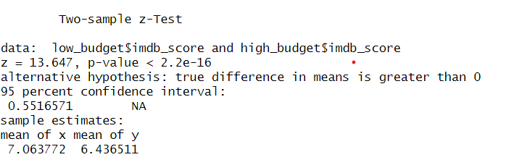
Conclusion
The p-value is less than 2.2e-16 which is small. Therefore, the null hypothesis is very incompatible with the data that have been collected.
We can therefore reject the null hypothesis in favor of the alternative hypothesis. We can conclude that high budget R movies tend to have lower imdb scores than low budget R movies.

Slide 10
Hypothesis B: Low gross movies has higher imdb scores than High gross movies. Null Hypothesis: There is no significant difference in the average imdb scores between high gross movies and low gross movies
Approach: Z-test

Slide 11
We fist split the data into two groups, and use the library function to evaluate the p-value and z score for the comparison between two groups.
High_gross<-movies[movies$Gross=='High',] Low_gross<-movies[movies$Gross=='Low',] z.test(x=Low_gross$imdb_score, y=High_gross$imdb_score, alternative='greater', sigma.x=sd(Low_gross$imdb_score), sigma.y = sd(High_gross$imdb_score))

Slide 12
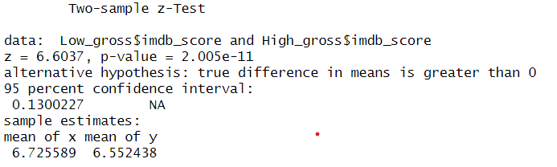
Conclusion
The p-value is 2.005e-11 which is smaller than the critical value 0.05. The z score is 6.6037. In conclusion, we can reject the null hypothesis in favor of the alternative hypothesis. We can conclude that low gross R movies tend to have higher imdb scores than high gross R movies.
The p-value is less than 2.2e-16 which is small. Thereore, the null hypothesis is very incompatible with the data that have been collected.
We can therefore reject the null hypothesis in favor of the alternative hypothesis. We can conclude that high budget R movies tend to have lower imdb scores than low budget R movies.

Slide 13
Hypothesis C:Drama movies tend to have higher IMDb scores than Science Fiction movies Null Hypothesis: There is no significant difference in the average imdb scores between Drama and Science Fiction movies
Approach: Z-test

Slide 14
We fist split the data into two groups, and use the library function to evaluate the p-value and z score for the comparison between two groups.
Drama<-movies[movies$genre=='Drama',] Sci_Fi <- movies[movies$genre=='Sci-Fi',] z.test(x=Drama$imdb_score,y=Sci_Fi$imdb_score, alternative='greater', sigma.x=sd(Drama$imdb_score), sigma.y=sd(Sci_Fi$imdb_score))

Slide 15
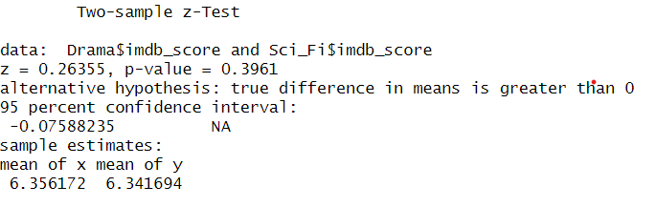
Conclusion
The p-value is 0.3961 which is greater than the critical value 0.05. The z score is 0.26355. In conclusion, we failed to reject the null hypothesis
The p-value is less than 2.2e-16 which is small. Thereore, the null hypothesis is very incompatible with the data that have been collected.
We can therefore reject the null hypothesis in favor of the alternative hypothesis. We can conclude that high budget R movies tend to have lower imdb scores than low budget R movies.

Slide 16

Thank you!
Xinyu Meng

